Slide 1
edX MOOC Student Dashboard
Work Learn S19 - Shenia Tung

Slide 2
Introduction
Work Learn Program
MOOC (Massive Open Online Course)
Student facing dashboard

Slide 3
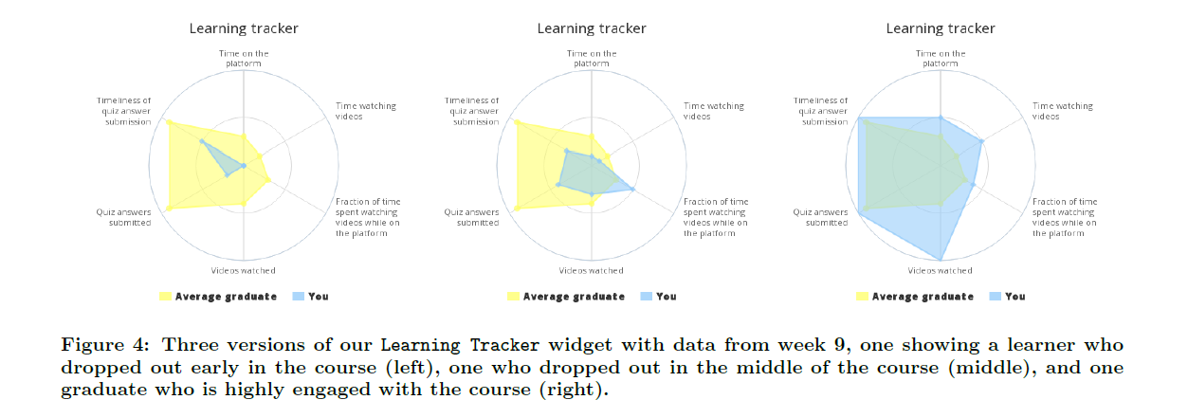
Design Concept
Discipline
Unique Environment
Feedback on progress
Figure: Davis et al.’s demonstration in their 2010 study [2], "Encouraging Metacognition & Self-Regulation in MOOCs"

Slide 4
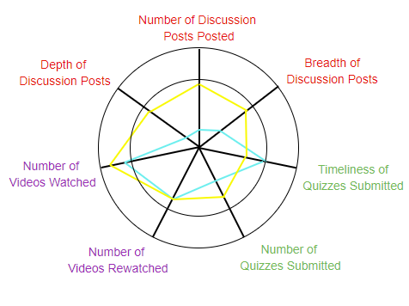
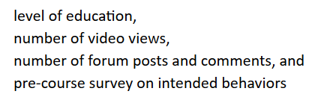
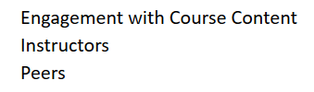
Progress Measurement
Engagement with content, instructor, and peers
Metrics: Video, Forum, Quizzes

Slide 5
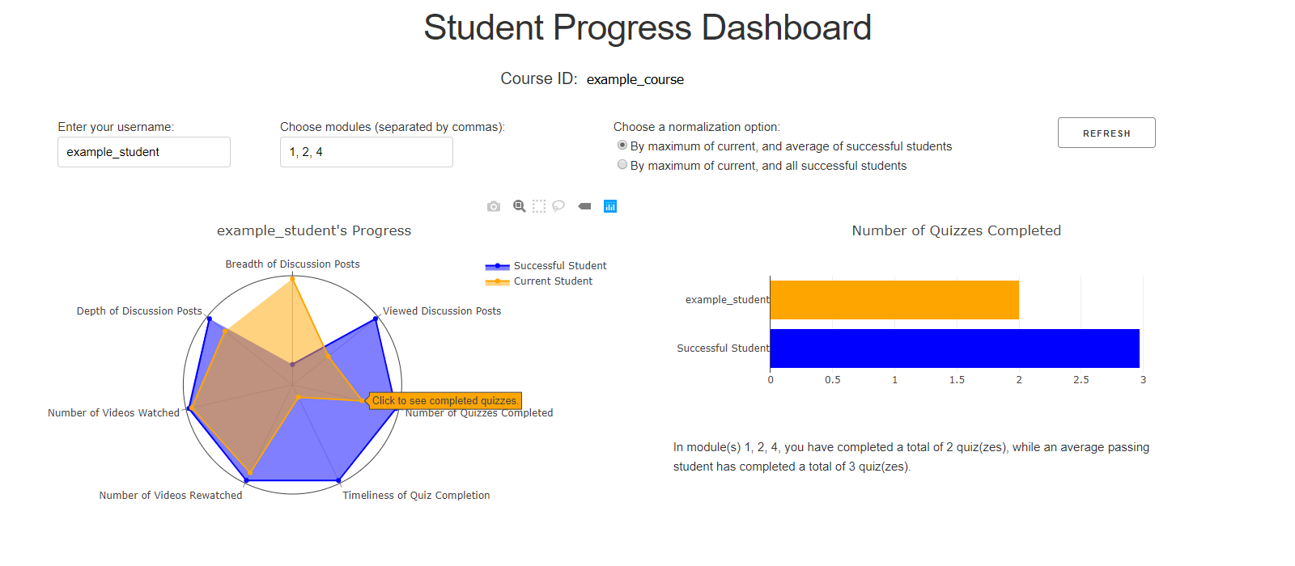
Dashboard Design

Slide 6
Program Structure
Storage
Extraction
Cleaning
Visualization
Python (pandas, numpy)
Python (math, Dash)
Google BigQuery
Edx Course Forum
Tableau/Excel
Python (pandas)

Slide 7
Course of Project
May
June
July
August
Defining Project, Research and Defining Student Engagement Metrics
Developing Prototype, Data Extraction
Application Development
Final Report

Slide 8
Difficulties Encountered
Metric Definition
Python - Google BigQuery Connection
Tableau Visualization
Data Normalization

Slide 9
Future Improvements
Automate: Python - Google BigQuery Connection
Automate: Discussion Thread - Module Mapping
Definition: edX Data Package Documentation
Interface: Authentication, Detail, Normalization Method
Scope: Expansion

Slide 10
GitHub - Documentation and Program Code
Shenia/MOOC-Student-Progress-Dashboard

Slide 11
References
Koller, D., Ng, A., Do, C., Chen, Z. (2013). Retention and Intention in Massive Open Online Courses. Educause Review.
Davis, D., Chen, G., Jivet, I., Hauff, C., & Houben, G. ([past]). Encouraging Metacognition & Self-Regulation in MOOCs through Increased Learner Feedback. LAL@LAK.
Pursel, B.K., Zhang, L., Jablokow, K.W., Choi, G.W., & Velegol, D. ([past]). Understanding MOOC students: motivations and behaviours indicative of MOOC completion. J. Comp. Assisted Learning, 32, 202-217.
Macfadyen, L., & Dawson, S. (2010). Mining LMS data to develop an "early warning system" for educators: A proof of concept. Computers & Education, 54, 588-599.
Wise, A.F., Speer, J., Marbouti, F., & Hsiao, Y. (2013). Broadening the notion of participation in online discussions: examining patterns in learners’ online listening behaviors. Instructional Science, 41, 323-343.
Wu, S., Rizoiu, M., & Xie, L. (2017). Beyond Views: Measuring and Predicting Engagement in Online Videos. ICWSM.
Bonafini, F., Chae, C., Park, E., & Jablokow, K.W. (2017). How Much Does Student Engagement with Videos and Forums in a MOOC Affect Their Achievement.
bigreddot (2018, August 20). Re: How to convert a matplotlib.pyplot to a bokeh plot. Retrieved from https://stackoverflow.com/questions/44423704/how-to-convert-a-matplotlib-pyplot-to-a-bokeh-plot
Stylesheet
https://codepen.io/chriddyp/pen/bWLwgP.css

